Slide 1
SCP policy – actions, opportunities and next steps
Sara Eppel
Head of Sustainable Products and Consumers Defra

Slide 2
Summary
Policy context and direction
What’s on, what’s off
Current activity, future opportunities
Questions

Slide 3
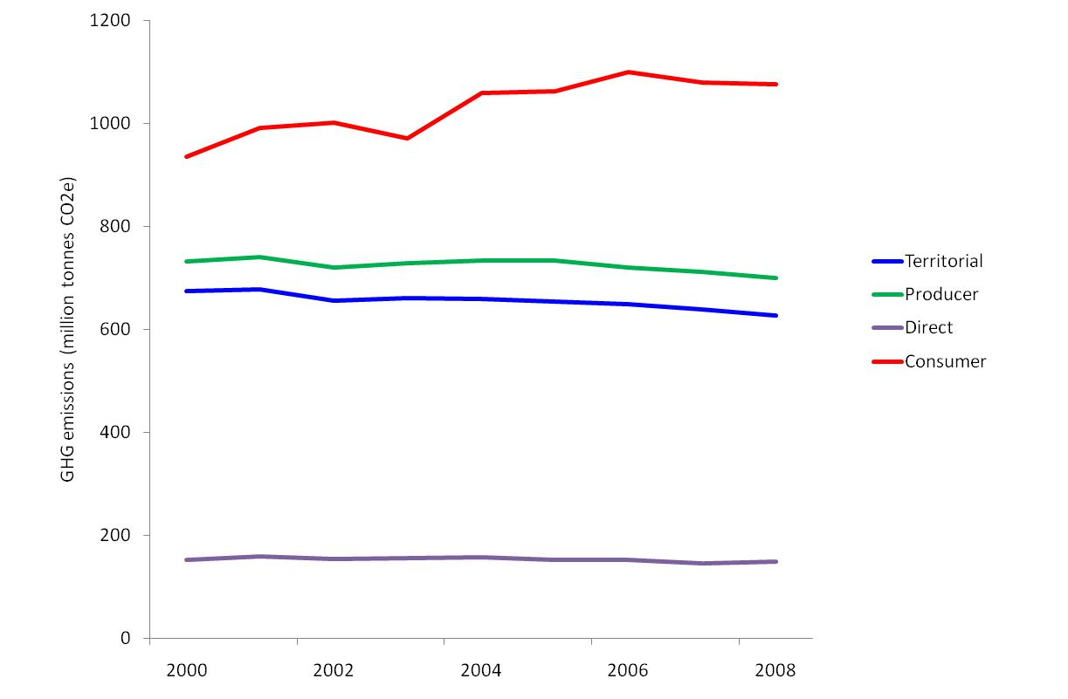
Context: UK consumption GHG emissions increased by 15% from 2000-2008
Territorial emissions refers to emissions from UK territory. Territorial emissions is the way greenhouse gas emissions are reported under the United Nations Framework Convention on Climate Change (UNFCCC).
Producer impacts refers to impacts associated with the activities of UK citizens. They differ from territorial impacts in that they include impacts from international aviation and shipping and some activities of UK citizens abroad; and exclude the corresponding activities of non-UK citizens in the UK.
Consumer impacts includes all global impacts in the production of goods and services that are consumed by UK domestic final consumption. This differs from producer impacts by including import related impacts and excluding export related impacts.
Direct emissions are those directly emitted by use of fossil fuels in the home and private motoring.
NB As direct emissions are constant for all 3 categories, they have been subtracted from subsequent sectoral breakdowns

Slide 4

Consumption areas with the most significant sustainability impacts, EU wide
Other (including tourism and leisure)
(c. 5%)
Clothing
(5-10%)
Buildings and appliances
(20-35%)
UK product impacts are similar to this EU-wide pie-chart
Passenger transport (15-20%)
(Figures represent % of environmental impacts across the EU25)
Food and drink (20-30%)

Slide 5
75% of individuals’ carbon impact is through the product and services we buy and use

Slide 6
Defra’s policy approach to dealing with these challenges
To set the UK policy frameworks , and influencing the EU, for a sustainable, low carbon economy, with resource efficiency the norm
To work with industry to improve understanding and willingness to take account on a range of lifecycle environmental impacts, throughout the supply chain
To develop our understanding of behaviours, establish peoples’ willingness to become more sustainable, and create policy opportunities

Slide 7
getting business and consumers to raise standards and to change the supply chain
REDUCED INPUTS: energy, water, materials, land
Seek recovered materials
Sell higher-
performing products
Demand better products
Recover waste
Remanufacture
Less raw material
Distribution and retail
End of life
Production
Source better products
Consumer use
Facilitate waste recycling
Innovate in design
and technology
Save energy and water, reduce waste
REDUCED OUTPUTS: greenhouse gases, air emissions, effluent, solid waste

Slide 8
Coalition Government approach
Less regulation – new is very difficult, old are being re-examined for effectiveness and streamlining
More behavioural approaches – as alternatives to regulation; as ways of making existing regs work, and nudging change
More action by business: seen as business making the right contribution to public policy goals
Updating our evidence base

Slide 9
Current tools in the SCP policy box
Supply chain – measure and manage:
  Carbon footprinting (revised PAS 2050) published 30 Sept
  Product Category Rules or Supplementary Guidance for food groups and home improvement. Open-source access :Wrap – Products Research Forum,
  Looking at carbon, energy, water, biodiversity (later)
  Water foot printing Guidance - 2012

Slide 10
Standards, labelling and eco-design
  Standards : Eco Design and Energy Labelling Directives; Govt procurement;
  11 products regulated, saving 7MtCO2/yr by 2020, and almost £1Bn off consumer electricity bills; further 8 products in progress
  Government Buying Standards (GBS);
  Ecolabel – voluntary scheme, limited take up in the UK, but grown from 17 to 1700 products in 2 years
  2012 review of EU SCP Action Plan, Eco-Design Directive – potential opportunity for wider issues to be integrated (energy related products, waste prevention, product lifetimes)

Slide 11

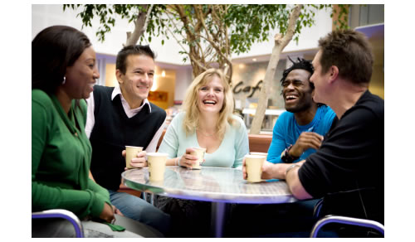
Voluntary action with business:
Roadmaps, responsibility deals
http://defra.gov.uk/environment/consumerprod/products/index.htm
REVIEW EVIDENCE
Look at both the
impacts of product across lifecycle and
- current interventions.
Evidence reviews published:
MILK
CLOTHING
TVs
WCs
PLASTERBOARD
WINDOWS
CARS
DOMESTIC LIGHTING
ELECTRIC MOTORS
FISH AND SHELLFISH
ENGAGE STAKEHOLDERS
Discuss and agree the evidence with stakeholders from across the product lifecycle
Extensive stakeholder engagement:
MILK
CLOTHING
PLASTERBOARD
WINDOWS
FISH AND SHELLFISH
WCs
ELECTRIC MOTORS
Initial stakeholder engagement
but no furtther action:
TVs
CARS
DOMESTIC LIGHTING
ACTION PLAN and Implementation
Develop a plan for improving product sustainability.
Action plan published:
MILK – now DAIRY
CLOTHING
PLASTERBOARD
WINDOWS
WCS
ELECTRIC MOTORS
Not yet published:
FISH AND SHELLFISH

Slide 12
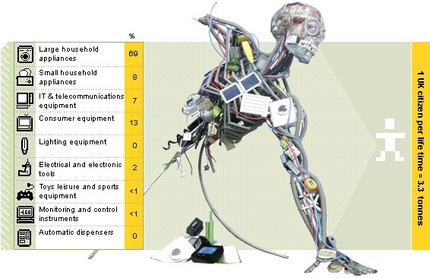
Product Lifetimes Study
Project looked at:
Environment: Whether longer product lifetimes would be better for the environment
Social: Consumer attitudes and behaviours to product lifetimes
Economic: The costs and benefits of longer product lifetimes, and where they would fall
Possible actions and next steps

Slide 13





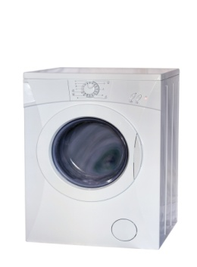



The environmental case
The longer a product lasts, the greater the time over which the “whole lifecycle” impacts are spread, and hence the less significant these impacts will be.
But older products can be less efficient than more modern versions.
So the study modelled impacts for 9 sample products:
Non- Energy Using
Energy Using
Faster innovation
Slower innovation

Slide 14
Environmental case: findings
☺
Lifetime extension saves the environmental impacts associated with producing more products, and this saving generally outweighs
  any environmental impact from refurbishment or upgrading processes and
  benefits achieved through innovation (more energy efficient products, and products being manufactured in more environmentally efficient processes)
There will be some exceptions eg
  if products converge, reducing the number of products required overall; or
  rapid shifts in efficiency of products which are frequently used eg cars (to electric), lighting (to LED).

Slide 15

Attitudes and behaviours
Product’s ‘lifetime’ is not fixed - determined by inherent durability of a product & actions taken in use: nature vs. nurture
Behaviour is sporadic & idiosyncratic: sometimes seeking more durable products; taking care of them in use; or treating products as disposable.
Limited concerns about product durability, but people wanted reliability
Desire to achieve good value from their purchases – price and brand were proxy indicators of value
Functional service products (e.g. washing machines) highlighted as items participants wanted to last
Limited attempts to prolong lifetime of products - barriers inc. lack repair
Key Barriers
Fashion
Agency
Quality of products
Cheap products
Consumers
powerless
Lack of info on lifetimes
Services e.g. repair
Wanting ‘value’

Slide 16
3 themes emerged from participants attitudes and behaviour
😐
Up to date
Product look
Inc. clothes, electronics
Work horse
How product
Investment
Relatively
Expected to last reliably for short period of time
Repair usually not an issue
People claimed to try give ‘perfectly good’ products a second life.
Unwanted products end up in bin/tip
Inc. major & small appliances, large furniture
Expected to last until broken
Considered repair to extend lifetime, but many barriers
Rare 2nd life as broken on disposal
functions is of key importance
is key
Proxies of price, brand and quality used to signify lifetime
Longer lifetime important: brand key signifier of product worthy of investment.
Repairs considered and efforts made to take care of products
2nd life envisaged at disposal, but potential issue of products being too ‘out of date’
expensive, ‘quality’ purchases

Slide 17
Business case: the measures investigated
INCREASE DESIGN LIFE
OPTIMISE USE
INCENTIVISE CHANGE
Design for Durability
Voluntary Lifetime Declarations
Mandatory Lifetime Declarations
Extended Warranties
Leasing
Aftercare Services
Deposits and Buy Back
Individual Producer Responsibility
Awareness Campaigns
Government Support
Enhanced Capital Allowances
VAT Incentives
Green Public Procurement

Slide 18
The business case: findings
😐
Impact of the possible measures on the UK economy is mixed.
Manufacturing impact is broadly negative, but UK exposure is limited.
Distribution and retail are mixed, depending on the measure.
Repair, refurbishment and maintenance, and the second hand market all benefit.
UK growth opportunities in
high skilled research and development, and
low skilled or semi-skilled repair and maintenance.

Slide 19
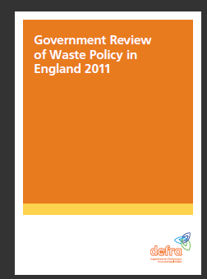
Next steps
No simple single policy solution, but several options have some potential to deliver improvements in some areas. Improvement depends on picking the right combination of: product, industry, consumer and measure.
Waste Review emphasises commitment to waste prevention as top priority and includes 15 commitments to action on waste prevention.
Commitments most closely related to product lifetimes are:
Supporting businesses to trial service based business models in new product areas eg leasing, long term maintenance. Initial focus on electricals, textiles and furniture.
Exploring how mandatory EU minimum standards for design of products might include new waste prevention requirements
Looking at options for improving consumer confidence in warrantees, guarantees and reliability of reused products
Improving information about repair and reuse services
Pilot projects looking at innovative ways to encourage people to extend the life of products
Partnerships between business and civil society to increase reuse

Slide 20
Online publication on:
http://randd.defra.gov.uk/

Slide 21
Stimulating citizen demand, a behavioural approach. Understanding the factors that influence us:
Infrastructure
Environmental
change
Experience
Norms
Culture
Attitudes
Social networks
Beliefs
Geography
Habits
Situational
factors
Influencing
human
behaviour
Behavioural
factors
Self-efficacy
Institutional
framework
Values
Identity
Access to capital
Social
learning
Awareness
Knowledge
Information
Altruism
Leadership
Perceptions

Slide 22
We know why people are acting and why they are not – the evidence shows...
What others are doing is key
Skills and ability more important than understanding
People learn from each other - peer to peer learning
What’s in it for me is important
Fit with self identity and status – who I am and how others see me
People’s behaviour follows the behaviour of others – social norms
People need to see exemplification – government and business should act first
People want to be involved – e.g. active involvement in decision making
Localism and community action – feeling connected to the place I live matters
Self efficacy & agency – knowledge, skills and feeling capable of making a difference
‘It just makes sense’ though making a difference matters
I won’t if you don’t and why should I - fairness and trust is key
People are more concerned by loss (costs) than gain – focus on what you’ll lose by inaction rather than what you’ll save by acting
Lifestyle fit – people don’t really want to change their lives
People ‘only want to do their bit’ – people will only do enough to alleviate guilt or feel good (and often this is a little)
People are sceptical about the problem, causes, and value of action
Ability to act and ease of action – e.g. access to the right infrastructure
Understanding the science of climate change is not a prerequisite for action
Not all sustainable behaviours are motivated by environmental concerns – some act to avoid wastefulness, to feel good, to make cost savings or be a little frugal
There is a disconnect between the small actions and the big issue
People desire feedback on progress and validation – they want to know they are doing the ‘right’ things and progress is being made

Slide 23
Key principles to inform behavioural approaches
We will if you will
Make the ‘right’ choices easier – co-design and partnership delivery involving Government, business, communities, and civil society can address the barriers to uptake, be more effective, and provide a mandate to help ‘green’ lifestyles incrementally
Leading by example and consistency are core foundations - demonstrating government and business are acting themselves as well as enabling others to act is critical. People don’t view policies in isolation - demonstrating consistency in national and local government policies can show the importance of the issue
Start where people are
Encourage people to see sustainable lifestyles differently - understand how people feel about current behaviours and ‘desired’ behaviours. Make the links to what different groups care about – go beyond environmental concern – and across lifestyles
No single solution
Multiple measures at multiple levels – design a package of measures to enable different groups to act. Development is informed by our understanding of what is more likely to work; of why people act and why they do not; and of people’s responses to different interventions

Slide 24
Influencing behaviour:
Published the Framework for Sustainable Living– to help organisations influence their customers, members
http://archive.defra.gov.uk/environment/economy/documents/sustainable-life-framework.pdf
Partnership projects with business
Action research to test innovative approaches to influencing behaviour

Slide 25
In summary
Supply chain measurement and action essential
Requires joint action by Govt and industry
Voluntary action can be facilitated by Govt, but industry must be ambitious for change
Business can help stimulate consumer demand for more sustainable products – civil society campaigns can be helpful!
Thank you

